Slide 1
Looking into the past - feature extraction from historic maps using Python, OpenCV and PostGIS.

Slide 2


ESRC ADRC-S
Administrative Data Research Centre – Scotland (ADRC-S)
part of the Administrative Data Research Network (ADRN)
An ESRC Data Investment
12 ADRC-S Work Packages
EDINA working on WP5 - Provision of Geocoding and Georeferencing tools

Slide 3
What and Why?
Prof(s) Chris Dibben and Jamie Pearce from UoE GeoSciences
Effects of past environmental conditions on (longitudinal) population cohorts
Trains – where (and which populations) did they run alongside in the past and bring their air pollution
Urban - did past populations live in predominantly urban or rural locales – were these same populations experiencing urbanisation
Industry - where were particular types of (polluting) industry located?
Greenspace and Bluespace – e.g. Parks and Water

Slide 4
Historic Maps – a record of past landscapes
ADRC`s remit is (all) of Scotland.
Manual capture (digitising) of features from historic maps not going to scale given resources available.
Chris and Jamie`s challenge to EDINA – is it possible to automagically capture features from historic maps?
Historic maps in Digimap historic
For the purpose of this work we are using (higher quality) full colour scans of historic maps provided by Chris Fleet @ NLS
Mainly been looking at 2 map series provided by NLS
http://maps.nls.uk/geo/explore/#zoom=15&lat=55.9757&lon=-3.1799&layers=168
http://maps.nls.uk/geo/explore/#zoom=15&lat=55.9757&lon=-3.1799&layers=10

Slide 5
Environment
Linux (Ubuntu)
Python (3)
Virtualenv – isolated Python environments
PyCharm Python IDE (Community Edition)
OpenCV – Computer Vision / Image Processing / Image Analysis
PostgreSQL - Datastore
PostGIS – Spatial query (analysis) engine
QGIS – Desktop GIS / PostGIS data viewer
(a bit of) ArcGIS for ArcScan (Line vectorization)

Slide 6

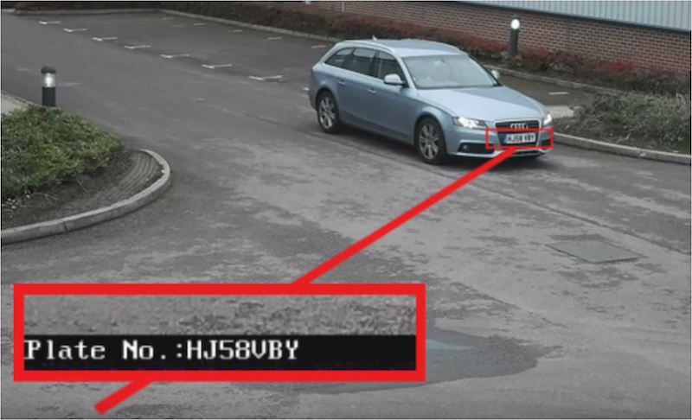
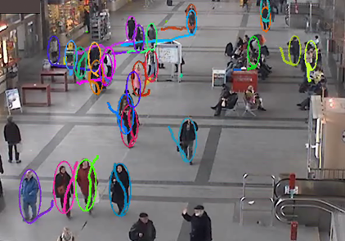
OpenCV
OpenCV (Open Source Computer Vision) is a library of programming functions mainly aimed at real-time computer vision

Slide 7
Python Libraries used
numpy - numpy (array) data structures central to all other libraries where we are manipulating image / raster datasets via python
cv2 - python interface to OpenCV
Shapely – (GEOS based) package for manipulation and analysis of planar geometric objects.
Fiona – (F)ile (i)nput (o)utput (n)o (a)nalysis. An alternative API to OGR to access and write vector GIS datasets e.g. Shapefiles / GeoJSON.
Rasterio – Raster (i)nput (o)utput. Rasteio is to raster GIS datasets as Fiona is to vector GIS datasets.
Snaql – Keep (templated) SQL query blocks seperate from python code and render (with context) the query block when needed.
assuming PostGIS, if you add in a map renderer like mapnik, then this lot gives you everything needed to do geospatial data analysis (raster and vector), data conversion, data management and map automation.

Slide 8
Python OpenCV Demo
Load image
Changing colourspaces – convert colour image to greyscale
Threshold image – partition greyscale image into bilevel foreground (white) and background (black) regions to simplify things.
Finding image contours. Contour (lines) seperate foreground regions from background regions. Having traced contours we can describe shape/size etc of foreground regions and relationship between regions.
Finding patterns / classifying features

Slide 9
Apply similar processes to
historic maps to extract geographic features
(1) Water features (Bluespace)
(2) Railways
(3) Urban Form / Change

Slide 10
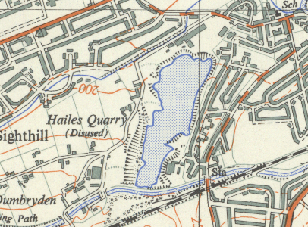
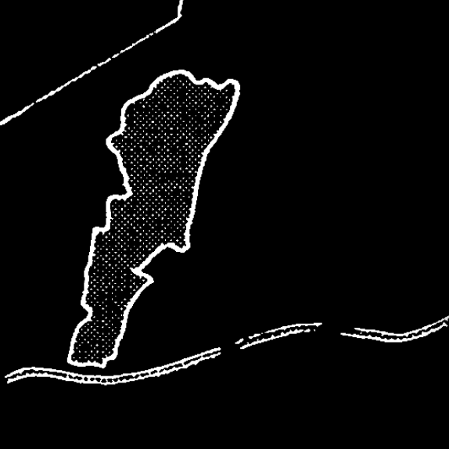
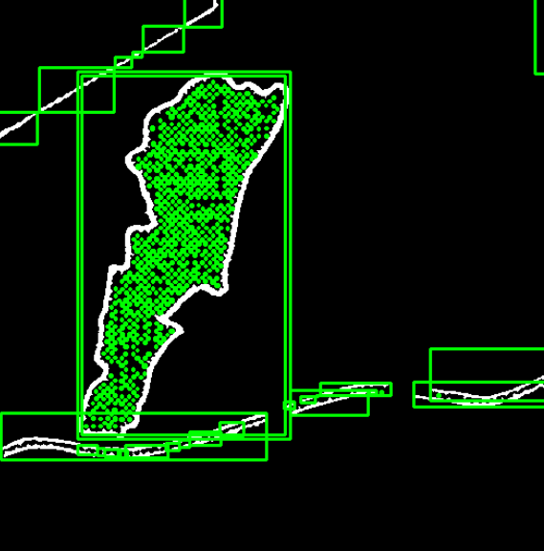
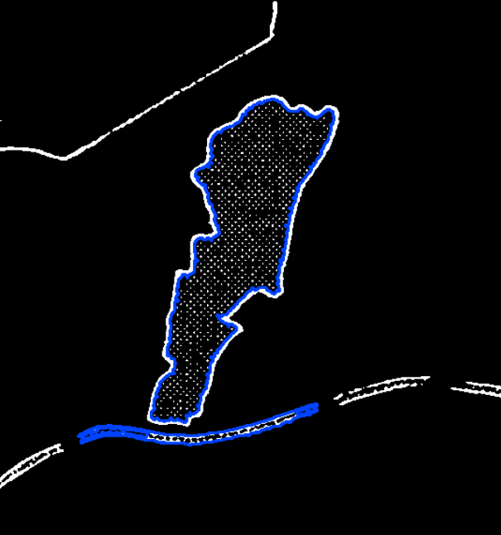
(1) Water features (Bluespace)
#15759 – extract 'bluespace'
Rivers / Canals / inland water shown as blue lines or stippled blue areas.
Threshold to isolate blue
pixels
Find contours – each stipple mark / line forms a contour
Contours form a hierarchy. Parents that hold child contours are water regions.

Slide 11
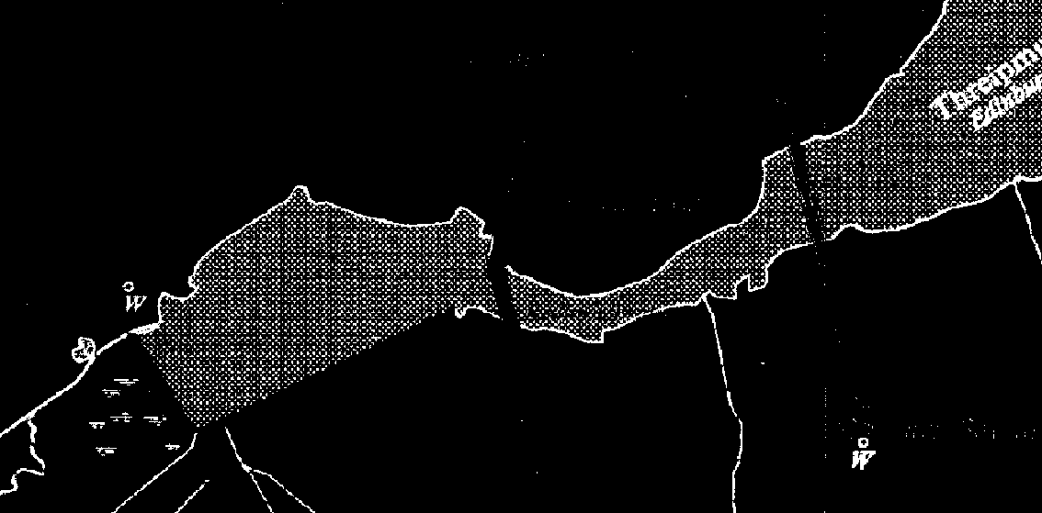
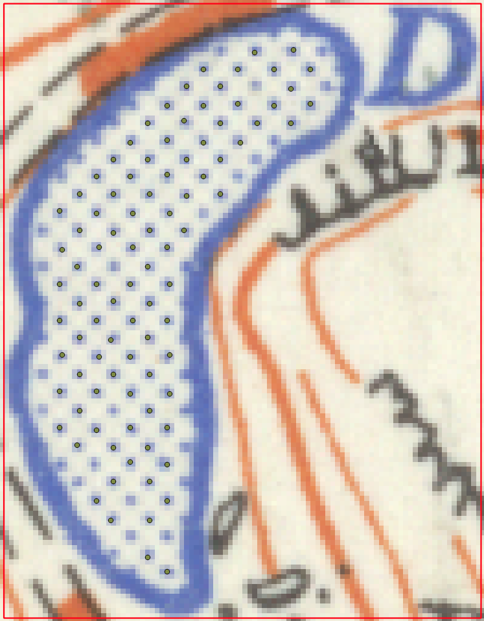
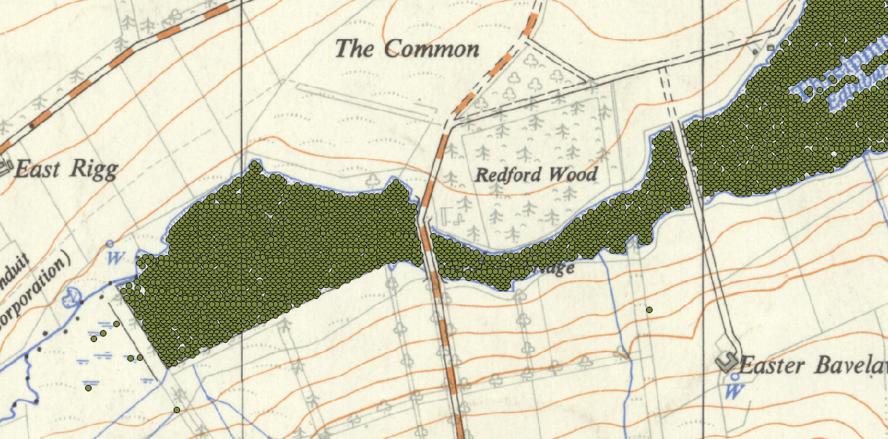
Method 2
Process breaks down when water regions are not entirely bound by blue lines or broken by other features (bridges).
Apply either of these methods of capturing blue stippled regions to other stippled regions e.g. green stippled regions (parks - greenspace)
So (alternative method) find every individual stipple and then forming groups of these gives water regions.

Slide 12
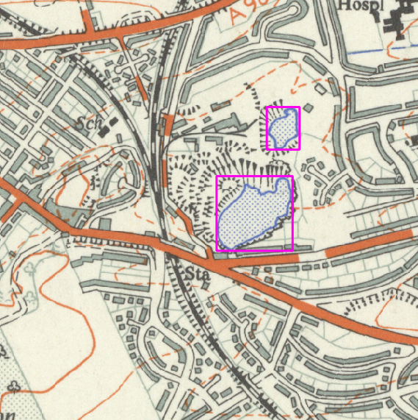
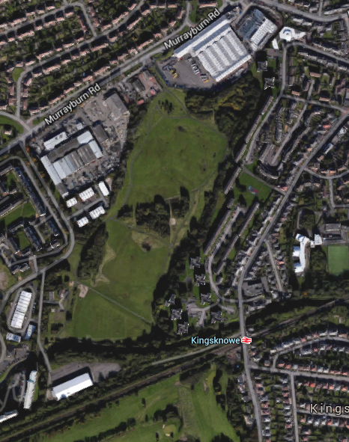
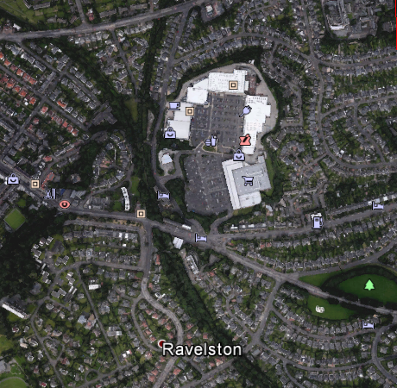
Change - old Edinburgh quarries change to shopping centres or from bluespace to greenspace!

Slide 13
First a diversion - threshold by colour seperation
Chris@NLS provided James Reid with 6 NLS OS 25K 1937-61 sheets.

Slide 14
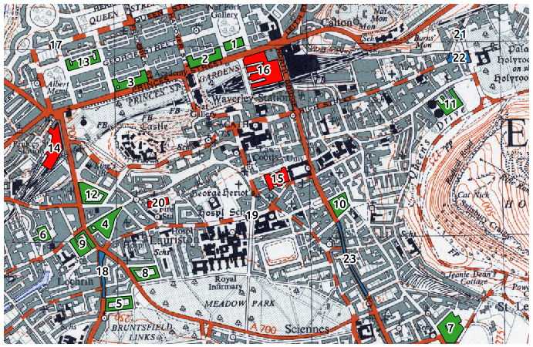

In QGIS digitised polygons covering groups of features of interest so we can explore values of RGB in the underlying pixels and use to inform colour seperation processing.

Slide 15
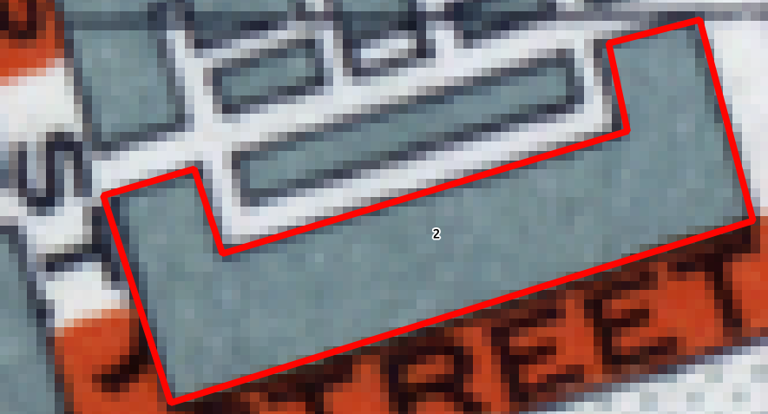
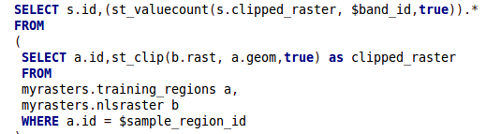

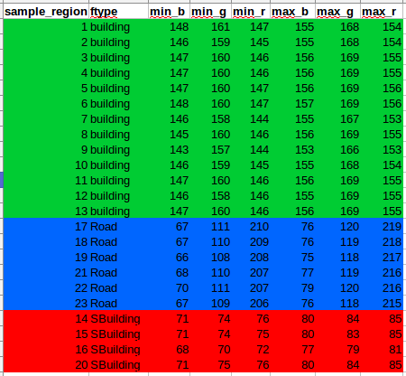

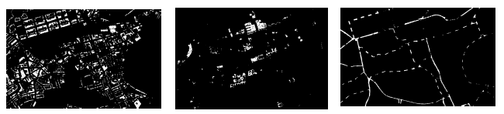
Load the training polygons and NLS 3 band raster into PostGIS and do spatial analysis to find pixel values in each polygon.
Calculate aggregate min/max values of RGB (BGR in opencv!) across each feature group and use these in OpenCV Python algorithm to do colour seperation on the source 25k image. More pre/post processing needed.

Slide 16
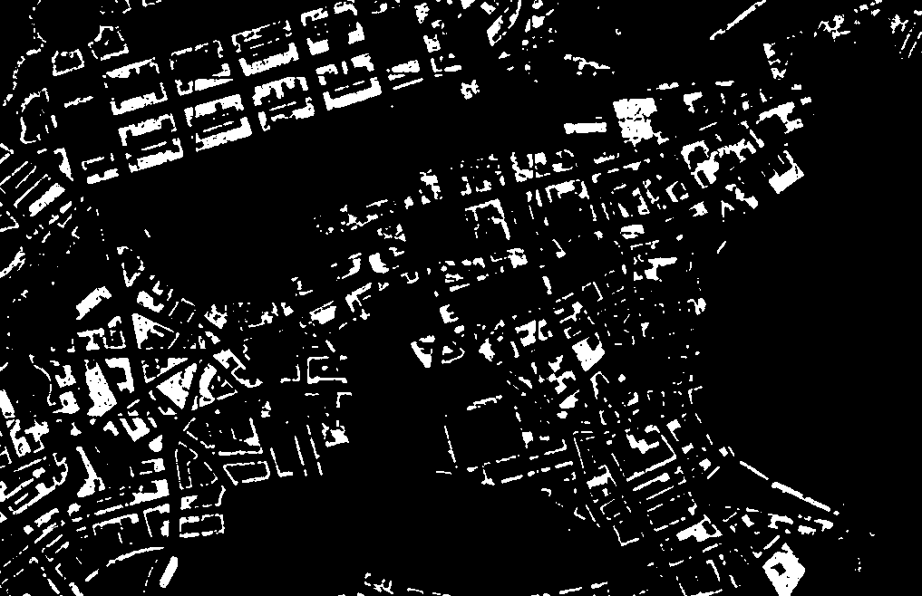
Pixels corresponding to (grey) buildings

Slide 17
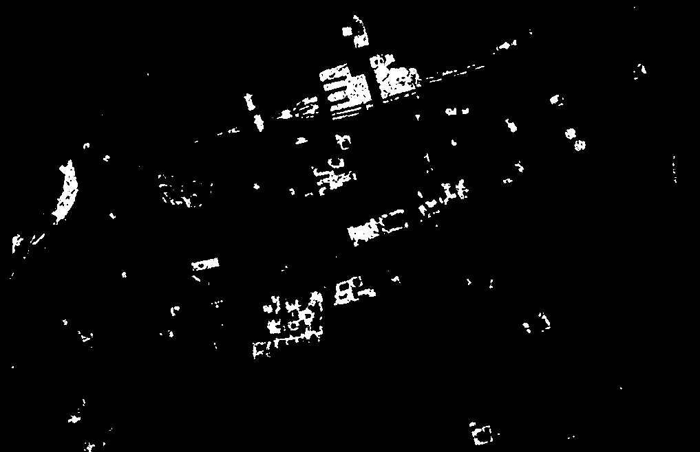
Pixels corresponding to (black) important buildings (and railway lines)

Slide 18
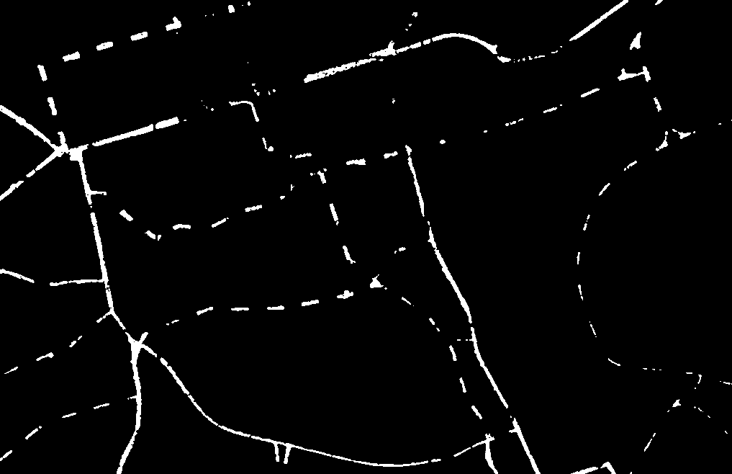
Pixels corresponding to (orange) main roads

Slide 19
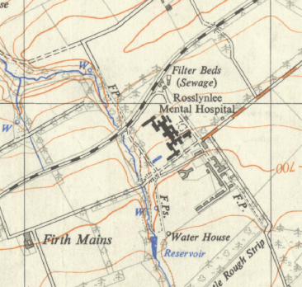
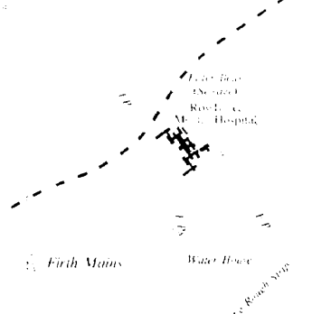
(2) Extracting Railways
Source 1:25,000 NLS Historic Map
“black” pixels extracted after running colour seperation process. Isolates dashes in railway lines (but also text/buildings)

Slide 20
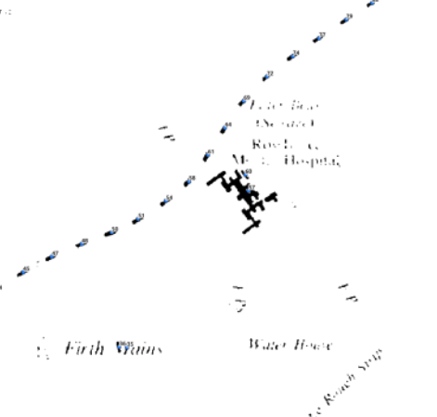
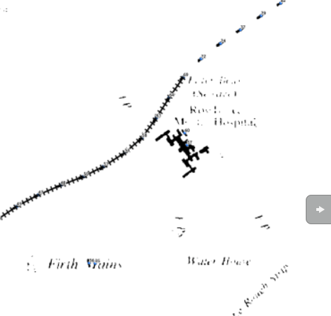
From dashes to (railway) lines
So do contour tracing and apply size/shape constraints to isolate the dashes in the railway lines only.
Join up neighbouring dash candidates to form railway lines

Slide 21
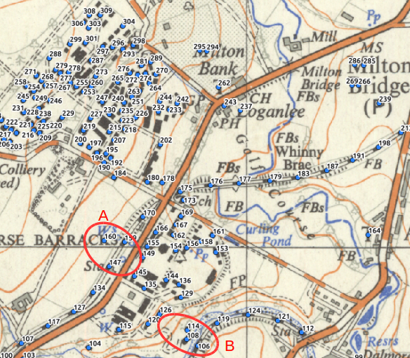
Process needs refined to cope with noisier, more complicated regions of the map
Not helped that some small buildings exhibit similar size/shape characteristics as dashes in railway lines.
A refinement might be to introduce a look-ahead constraint that minimises change in line direction as candidates are grouped since railway lines don`t make sharp 90 degree turns.
Complications…

Slide 22
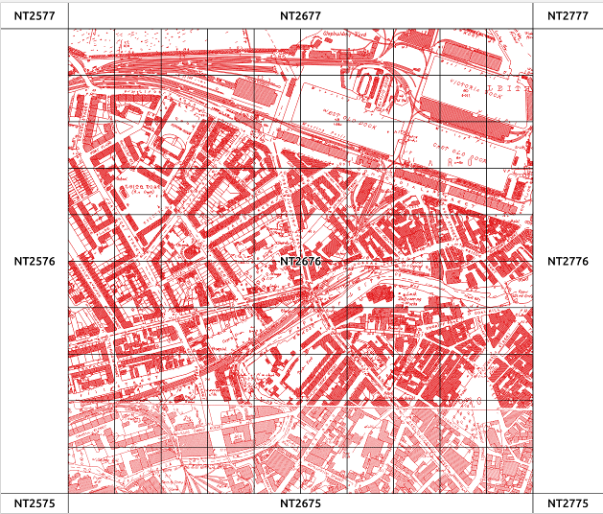
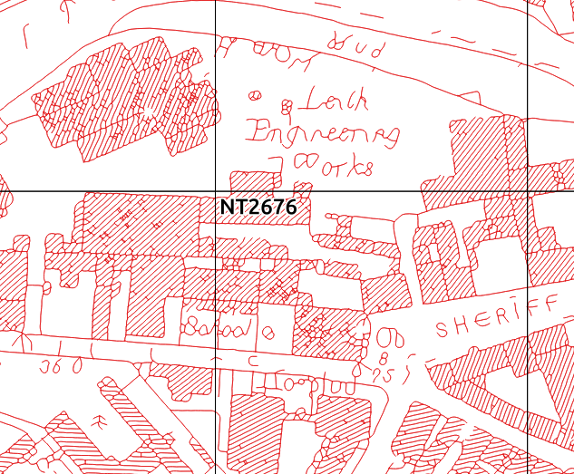
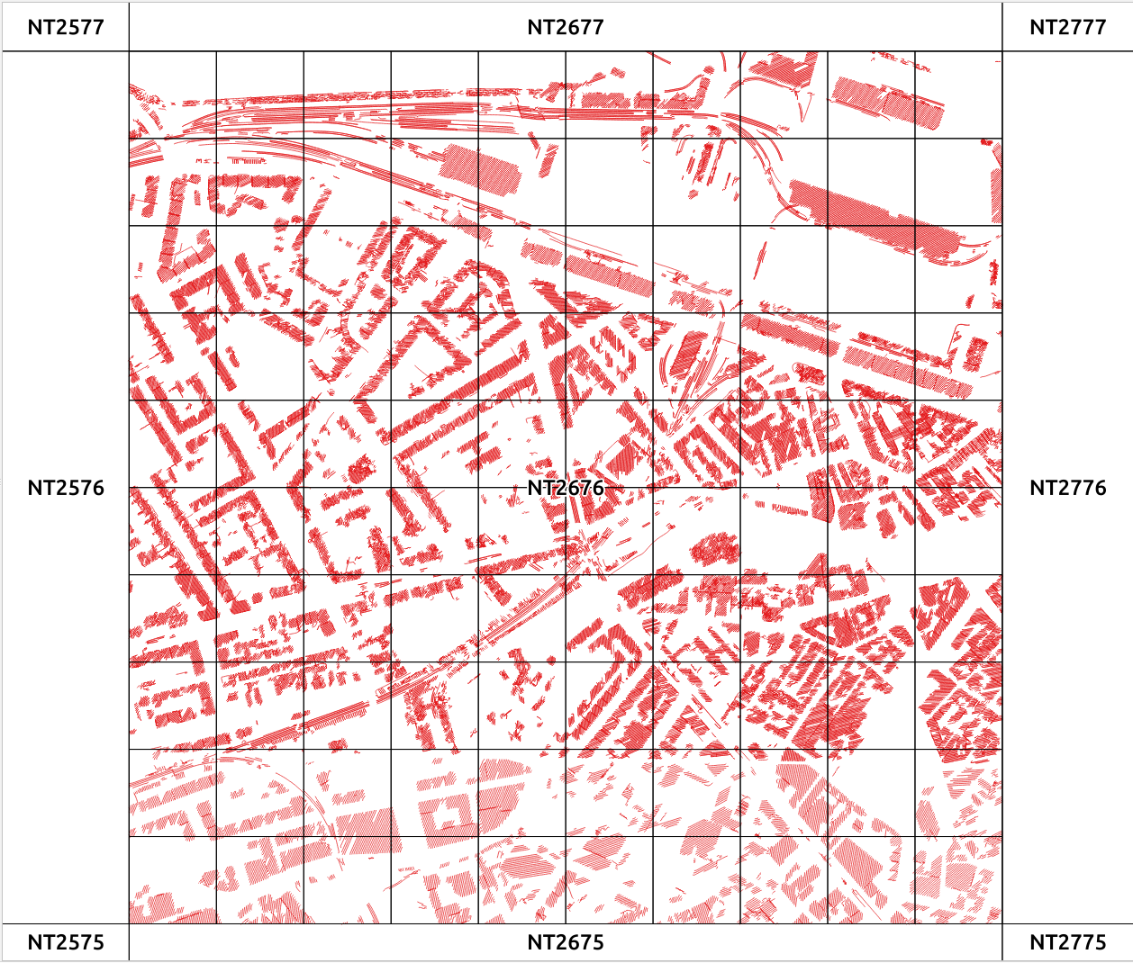


(3) Urban Form / Change
All lines captured from different historic NLS ca1900
Map series
Spatial analysis
Left with lines corresponding to hatched building regions

Slide 23
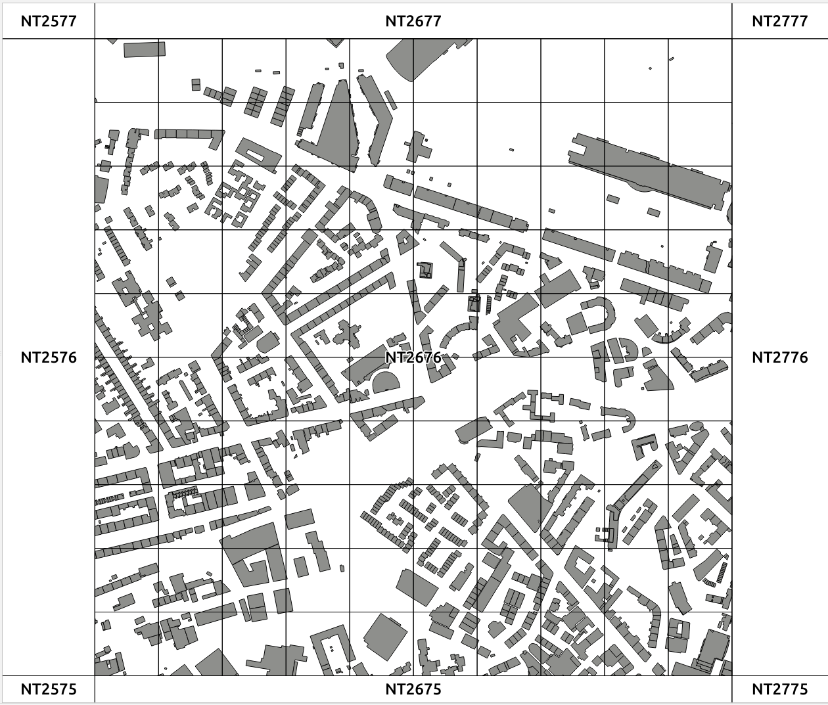
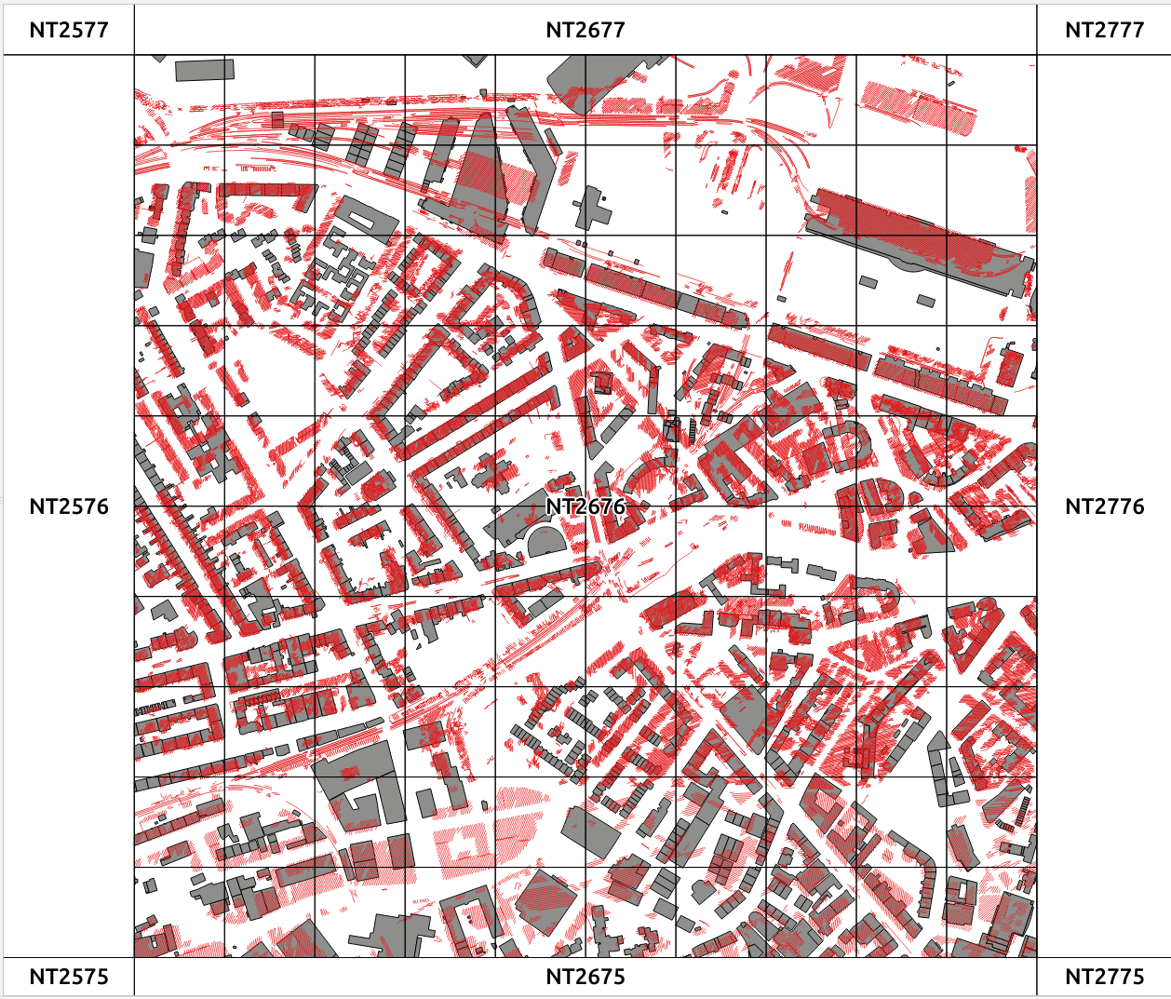
New vs Old (Buildings)
Current building footprints held in OS MasterMap
Lines from historic map selected as corresponding to hatched building areas overlain against OSMM building footprints

Slide 24
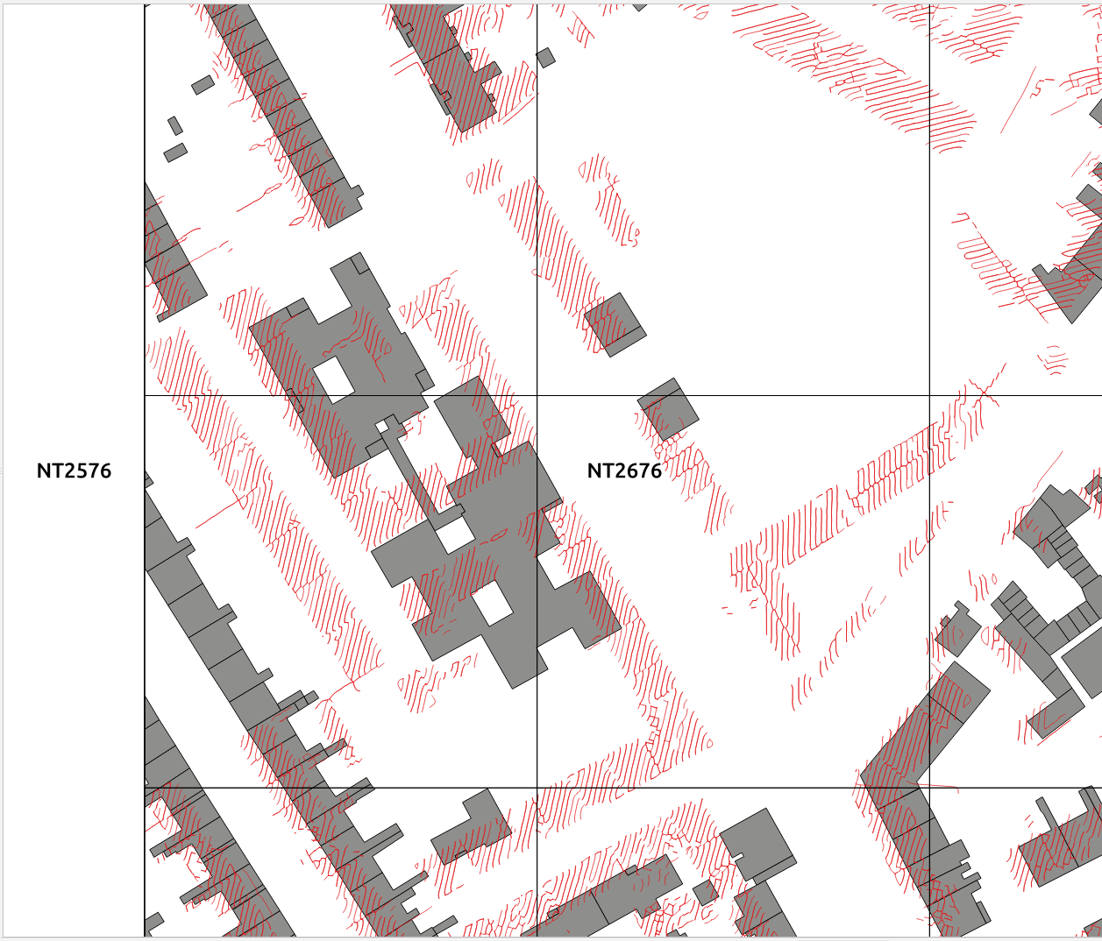
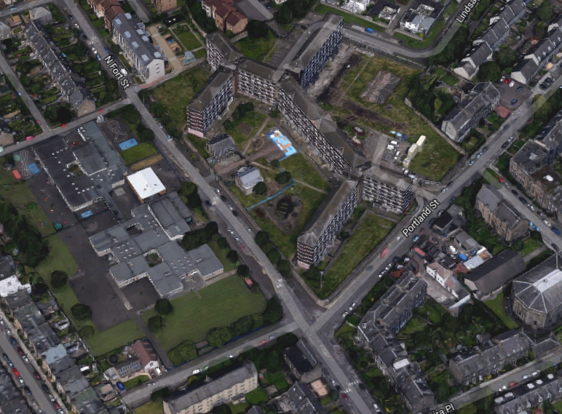
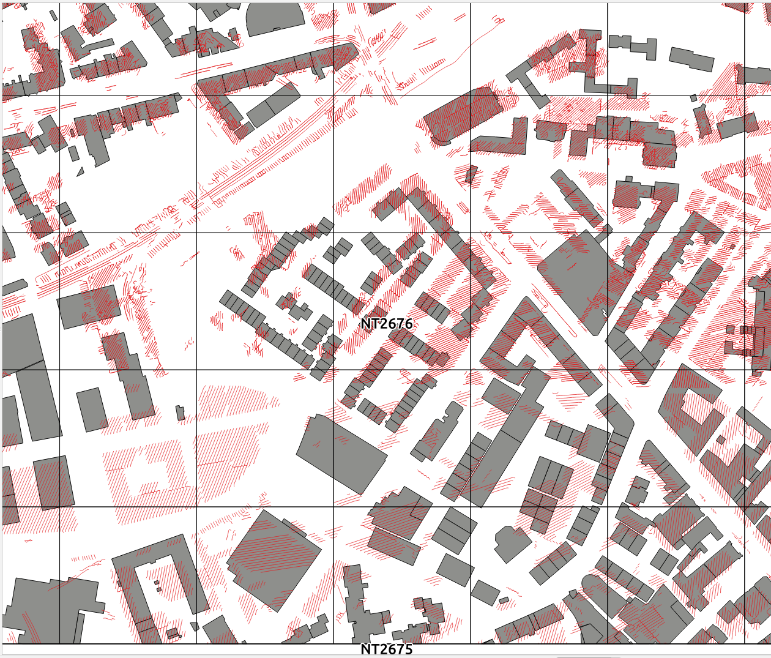
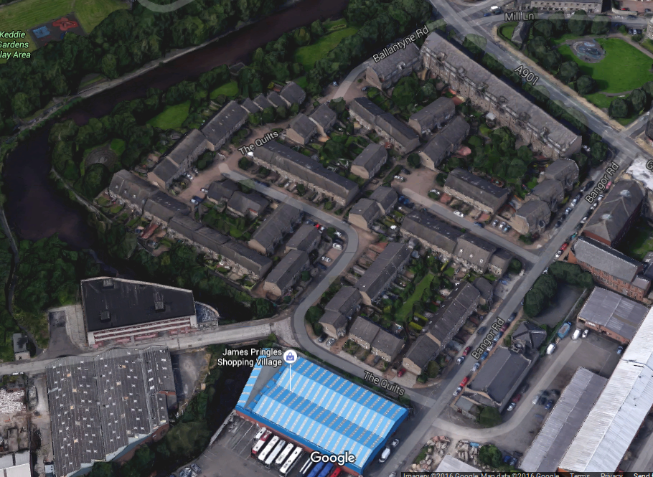
Examples of change in Edinburgh between ca1900 and today
All change
The locale of the Fort public housing project.
West Bowling Green Street &
Bowling Green Street

Slide 25
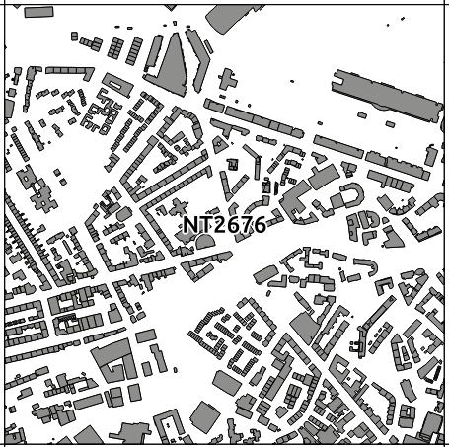
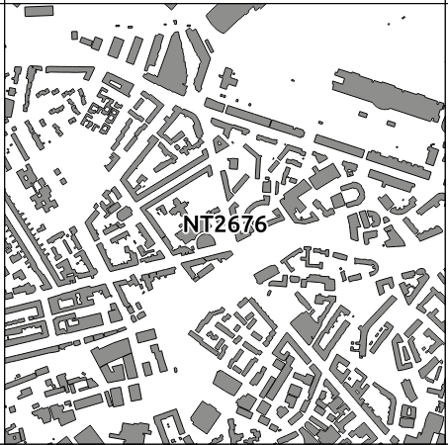
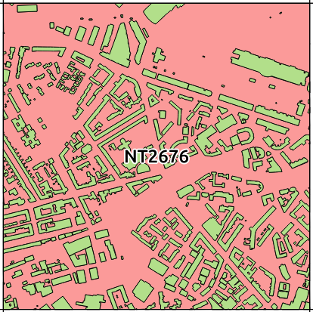
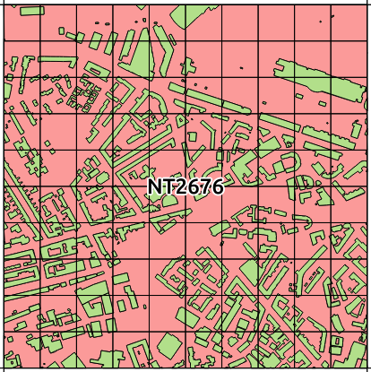
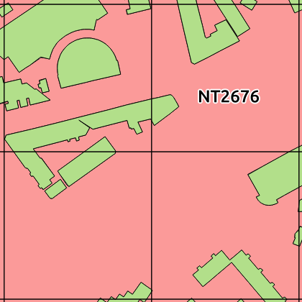
A measure of urbaness
Discrete building areas
Dissolve
is_building = Yes / No
Overlay a 100m x 100m sampling grid
% Building = Higher
% Building = Lower

Slide 26
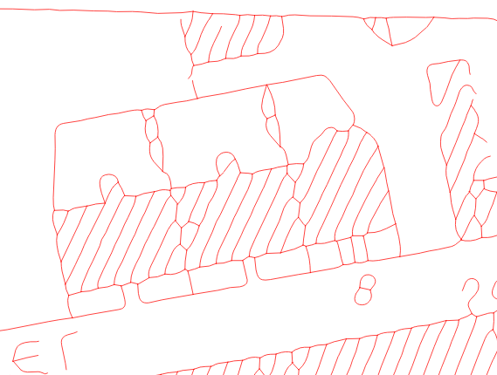
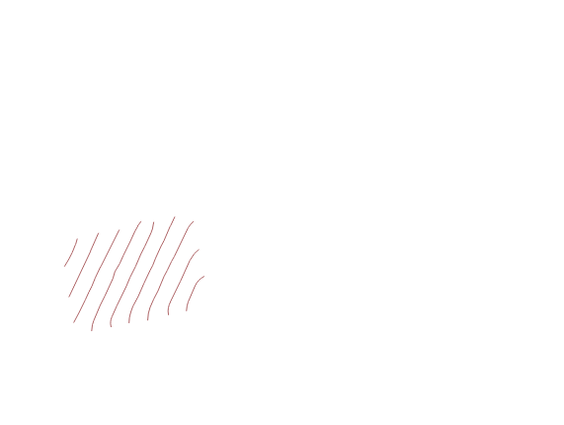
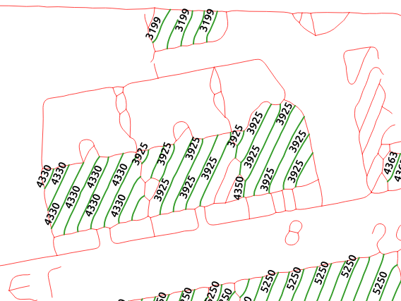
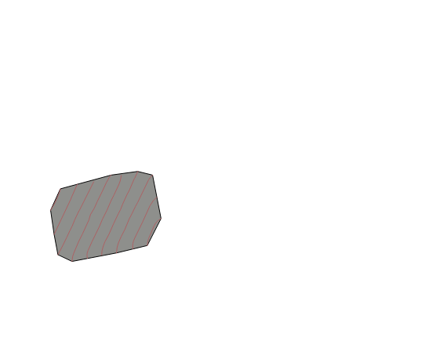
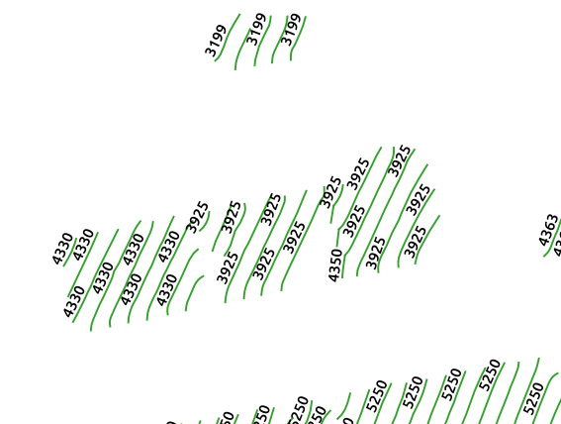
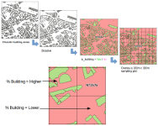
1. All lines pulled by from NLS historic map sheet. No intelligence about what each line represents.
Spaghetti!
From hatch lines to buildings
4. Derive a pseudo building polygon for each group.
Could place an MBR around them but instead...
2. Form groups of hatch lines.
Criteria for group membership is: spatial proximity; direction (azimuth);
lines are spatially disjoint; lines are parallel to one another.
5. … form a Convex Hull around the lines to provide a polygon for this group. For the historic maps this is the equivalent of the building footprint provided by the OS MasterMap data.
3. Final set of line groups. These correspond to building footprint. Other lines from the historic map did not meet group membership criteria and thus make no further contribution to analysis.
6. Repeat the % Building analysis for the complete set of convex hull polygons formed from all groups of hatch lines.

Slide 27
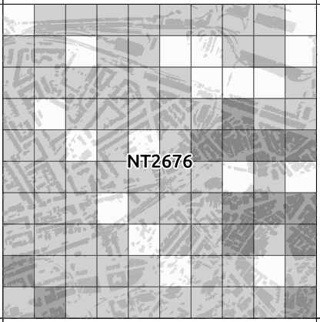
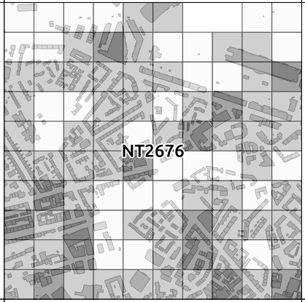
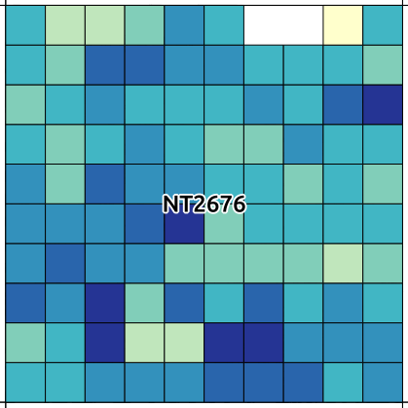
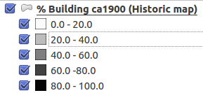
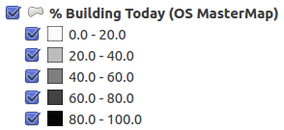

Output data products
End product would be a grid describing % building (built-up) across each 100m x 100m standard grid square in ca1900. Data could be aggregated upwards e.g. to produce a 1km x 1km grid. Using the same sampling grid could compute the same measure for modern data (I`ve used OS MasterMap but other OS OpenData could be used). Could then calculate + / - change between ca1900 and today / other time periods for which historic maps available.

Slide 28

Scaling up
Process repeated for whole of Edinburgh using all 19 NLS map sheets – urban form of Edinburgh ca1900.

Slide 29


Same 100m x 100m grid across Edinbrugh as a whole in ca1900

